Slide 1
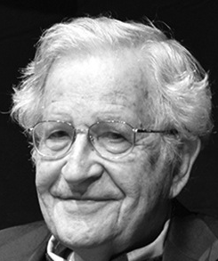
Normal Forms for Context-free Grammars
Course Instructor:
Dr. Sohail Iqbal

Slide 2
Recap: Simplification of CFG
One possible simplification

Slide 3
Why Normal Form?
Working with CFG, it is convenient to have them in simplified form
Easy one is Chomsky Normal Form
Usually longer/expanded than initial CFG
Helpful for algorithms
Notes:
Eg. A CFG could have many equivalents, but writing it in Chomsky normal form that becomes simpler and standard.

Slide 4
Chomsky Normal Form
A CFG is in Chomsky normal form, if every rule is of the form:
or
Where a is any terminal and A, B, and C are any variables- except that B and C may not be the start variable.

Slide 5
Chomsky Normal Form
Each production has form:
Type-II
Type 1
or
variable
variable
terminal
Notes:
One variable produces a concatenation of two variables OR a variable produces a single variable.

Slide 6
Examples:
Chomsky
Normal Form
Not Chomsky
Normal Form

Slide 7
Conversion to Chomsky Normal Form
Example:
Not Chomsky
Normal Form
We will convert it to Chomsky Normal Form

Slide 8
Introduce new variables for the terminals:
Notes:
For terminal replacement, we conventionally use the variable T

Slide 9
Introduce new intermediate variable
to break first production:

Slide 10
Introduce intermediate variable:
Notes:
For variable replacement, we use the variable V.

Slide 11
Final grammar in Chomsky Normal Form:
Initial grammar

Slide 12
In general:
From any context-free grammar
(which doesn’t produce )
not in Chomsky Normal Form
we can obtain:
an equivalent grammar
in Chomsky Normal Form

Slide 13
The Procedure
First remove:
Nullable variables
Unit productions
(Useless variables optional)

Slide 14
Then, for every symbol :
New variable:
Add production
In productions with length at least 2
replace with
Productions of form
do not need to change!

Slide 15
Replace any production
with
New intermediate variables:

Slide 16
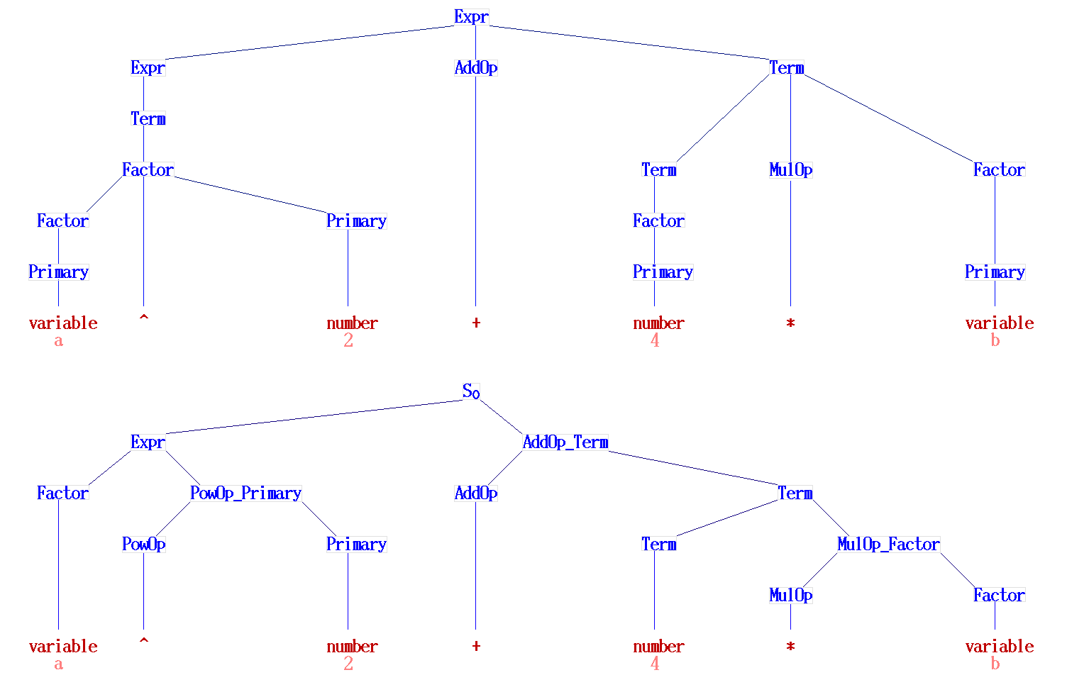
Abstract syntax tree of "a^2+4*b"
Source: https://en.wikipedia.org/wiki/Chomsky_normal_form

Slide 17
Syntax tree of "a^2+4*b“ in Chomsky NF

Slide 18
Observations
Chomsky normal forms are good
for parsing and proving theorems
It is easy to find the Chomsky normal
form for any context-free grammar
(which doesn’t generate )

Slide 19
Parsing Trees
However, Chomsky Normal form has its own limitations
It is not most efficient for parsing trees
This leads to emergences of other standards/normal form
One better for parsing is Greinbach form

Slide 20
Greinbach Normal Form
All productions have form:
symbol
variables
Notes:
A terminal will be followed by “zero or more” variables

Slide 21
Examples:
Greinbach
Normal Form
Not Greinbach
Normal Form

Slide 22
Conversion to Greinbach Normal Form:
Greinbach
Normal Form

Slide 23
Observations
Greinbach normal forms are very good
for parsing strings (better than Chomsky Normal Forms)
However, it is difficult to find the
Greinbach normal of a grammar

Slide 24
Interesting Note
Noam Chomsky (1928- ) is an
American linguist, philosopher,
cognitive scientist, historian,
logician, social critic, and political activist.
Sometimes described as "the father of modern linguistics,“.
He has spent more than half a century MIT

Slide 25
Practice: Exercise 2.1 to 2.6 from the Sipser’s book
Thank You!

